Slide 1
Embedded Computer Vision Team
Pushyami Rachapudi
Purdue University

Slide 2
Team
Pushyami Rachapudi (Team Leader)
Spencer Huston
Amol Jha
Shubham Bhokare
Zhi Kai Vinson

Slide 3
Research Focus

Slide 4
Camera Setup

Slide 5
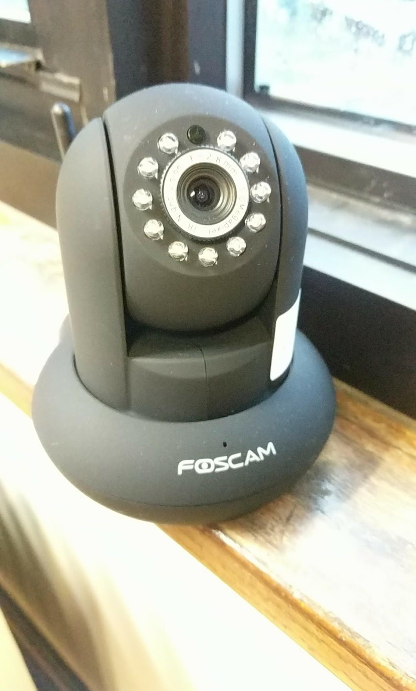
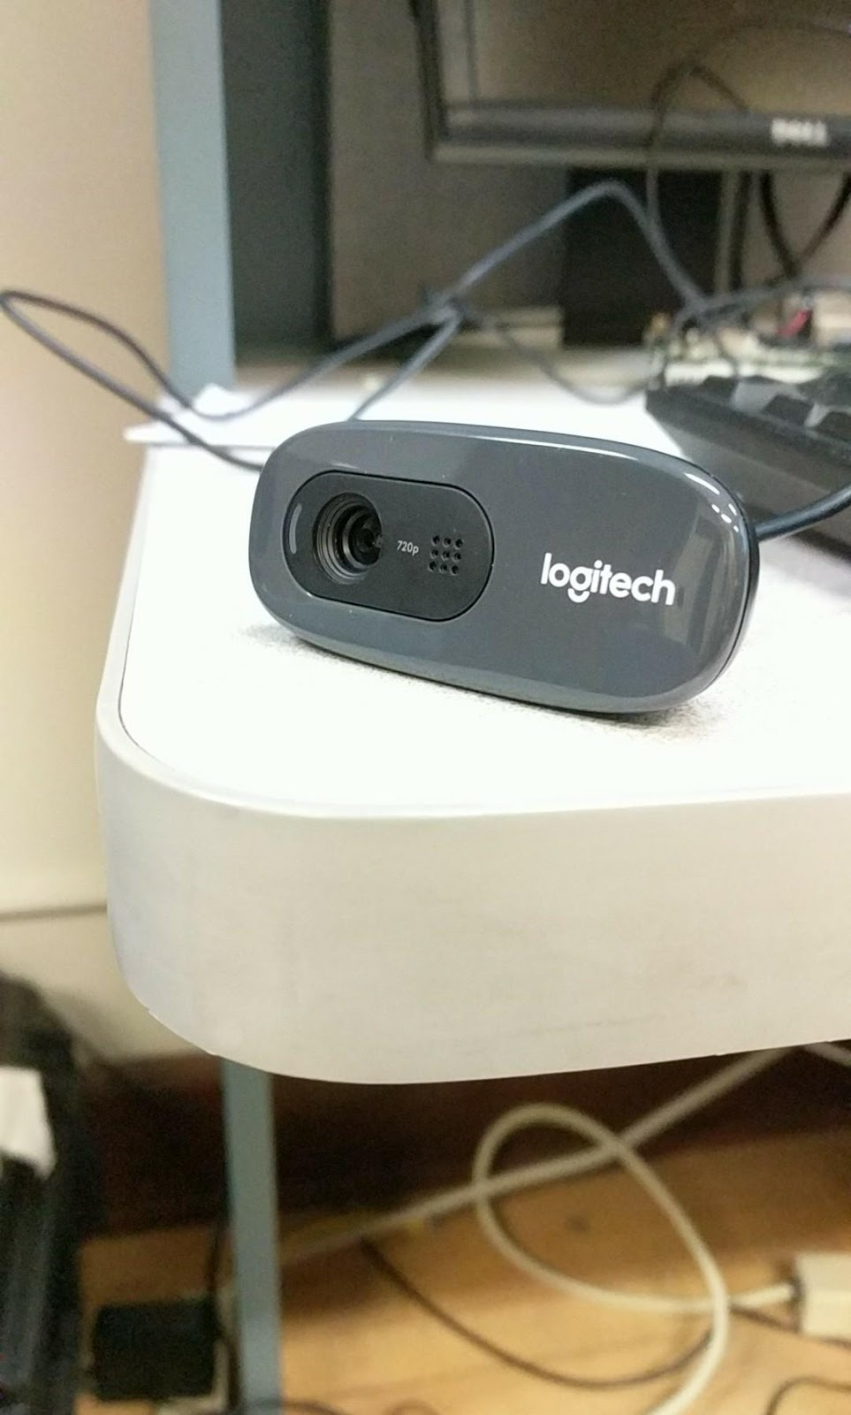
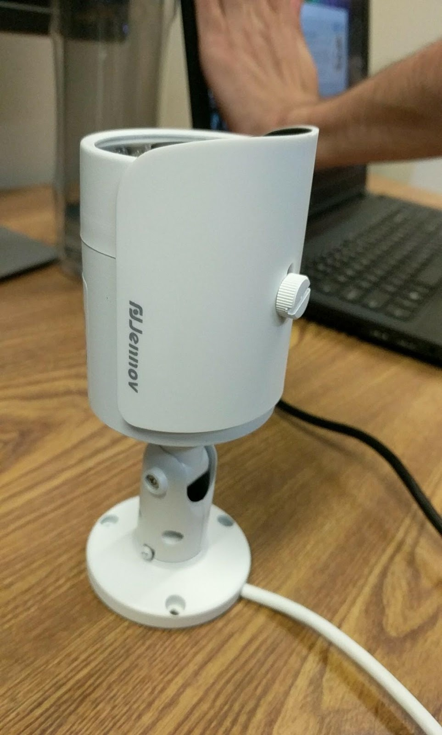
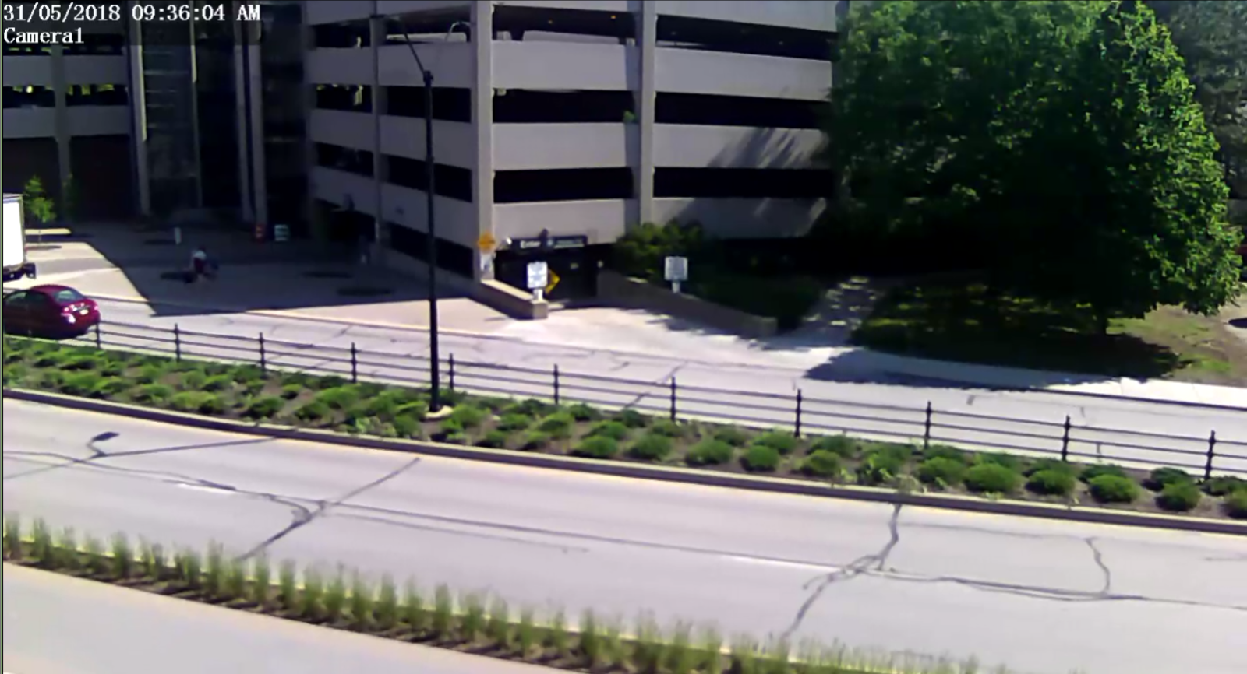

Foscam FI9821W | Logitech C270 HD | Jennov A73WG20-3E G-Series
 |  | Unavailable
FPS 25 fps, 30 fps Viewing Angle 70 degrees http://foscam.us/foscam-fi9821w-megapixel-wireless-ip-camera.html | FPS (max) 30 fps Viewing Angle 60 degrees http://support.logitech.com/en_us/product/hd-webcam-c270/specs | FPS (max) 25 fps Viewing Angle 72 degrees https://www.amazon.com/Jennov-Security-Surveillance-Outdoor-Detection/dp/B074MQP24Q
Pros Streaming on multiple devices | Pros Easy connection | Pros Unavailable
Cons | Cons Stream on single device | Cons Lack of documentation

Slide 6
Data Acquisition

Slide 7
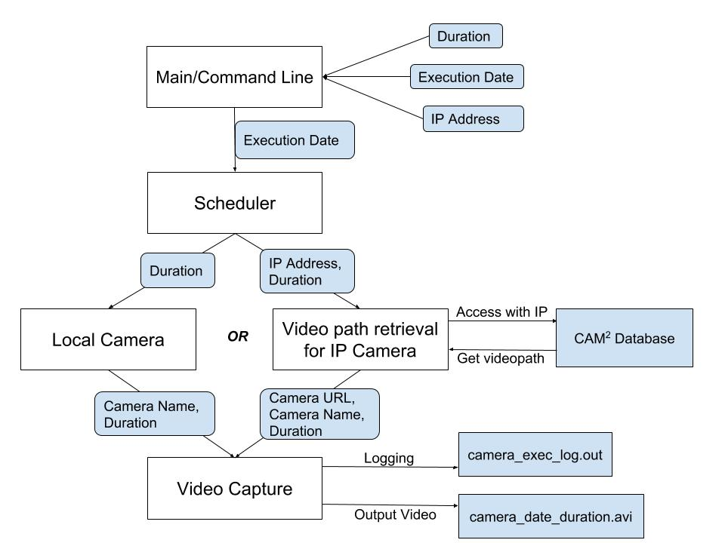

Slide 8
Intel’s Streamer

Slide 9
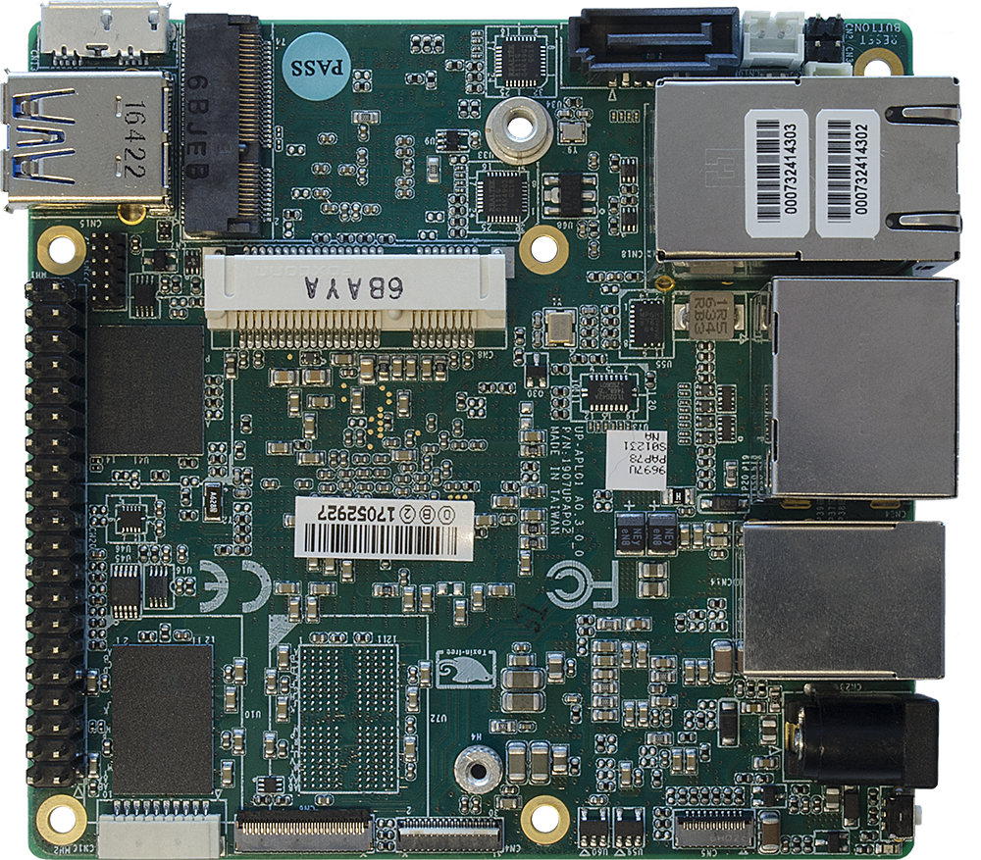
UP² Boards

Slide 10
What’s next?

Slide 11
Questions?

